Slide 1

Email Management system
Programed By :
Name : Nikita Suresh Mehtre
Enrollment Number: EBEON1121490384
Batch : 2021-6364

Slide 2
PROJECT ABSTRACT
Email Management System is a simple console based application without graphics, developed using Java programming language.
The purpose is to send and receive emails using Java.
This mini project utilizes various aspects of core-java language such as classes, methods, conditional statements, collection framework etc.

Slide 3
FEATURES
Login
Display emails,
Display sent emails,
Send email
Exit
Logout
Change Password
Set alternate email
Capacity of Mailbox

Slide 4
System Requirements
Software requirements:
Operating System: Windows 10 (20H2)
IDE : Eclipse 2021-09 (4.21.0)
JRE : jdk-17_windows-x64_bin
Hardware requirements:
Processor : 1th Gen Intel(R) Core(TM) i5-11400
Installed RAM : 16.0 GB
System Type : 64-bit operating system, x64-based processor

Slide 5
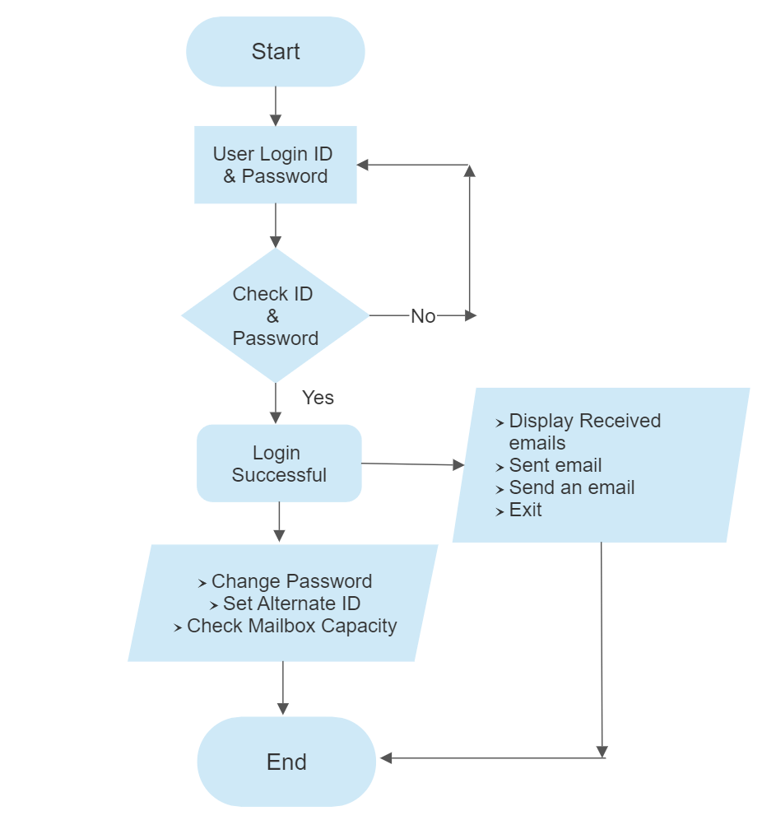
Flow Chart

Slide 6
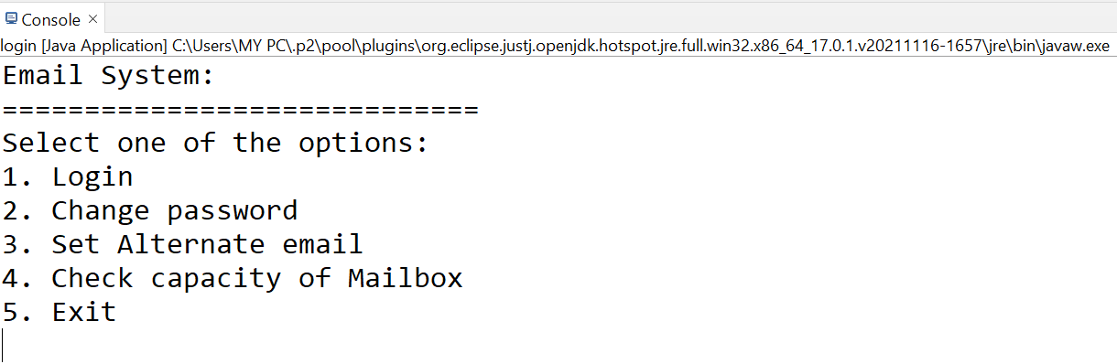
OPERATIONS
Scrshot1. First of all, displaying features provided for users in this project using Conditional Switch Cases

Slide 7
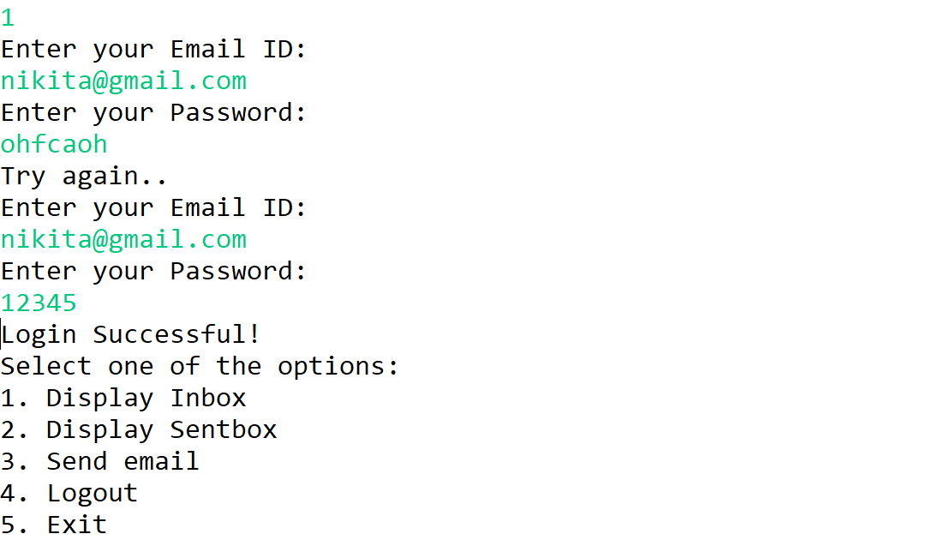
1. Login Feature
Scrshot2. As the user selects option 1, user will be able to view inbox after entering correct credentials. Hashmap used to store the ID and password

Slide 8
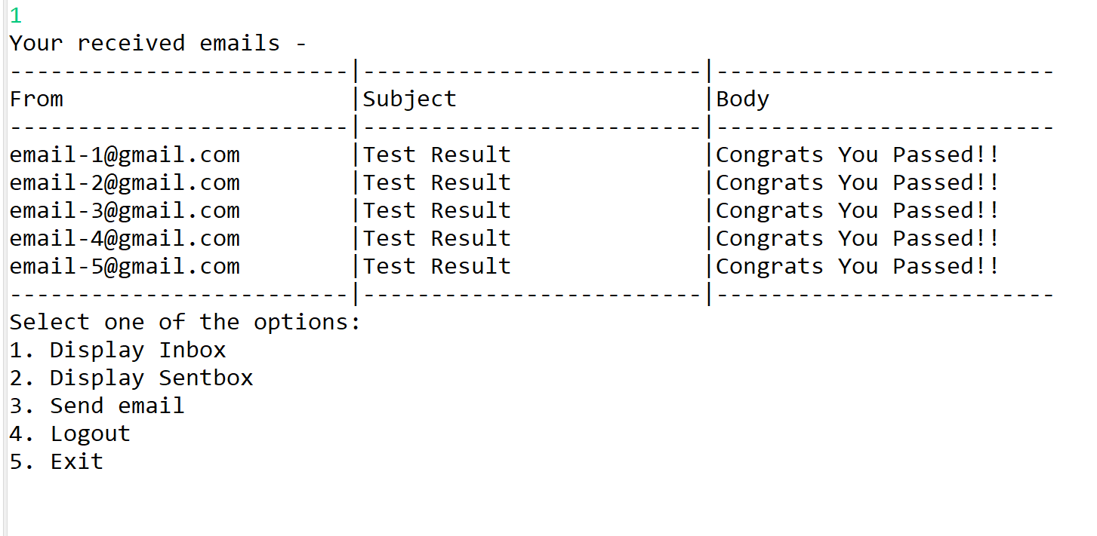
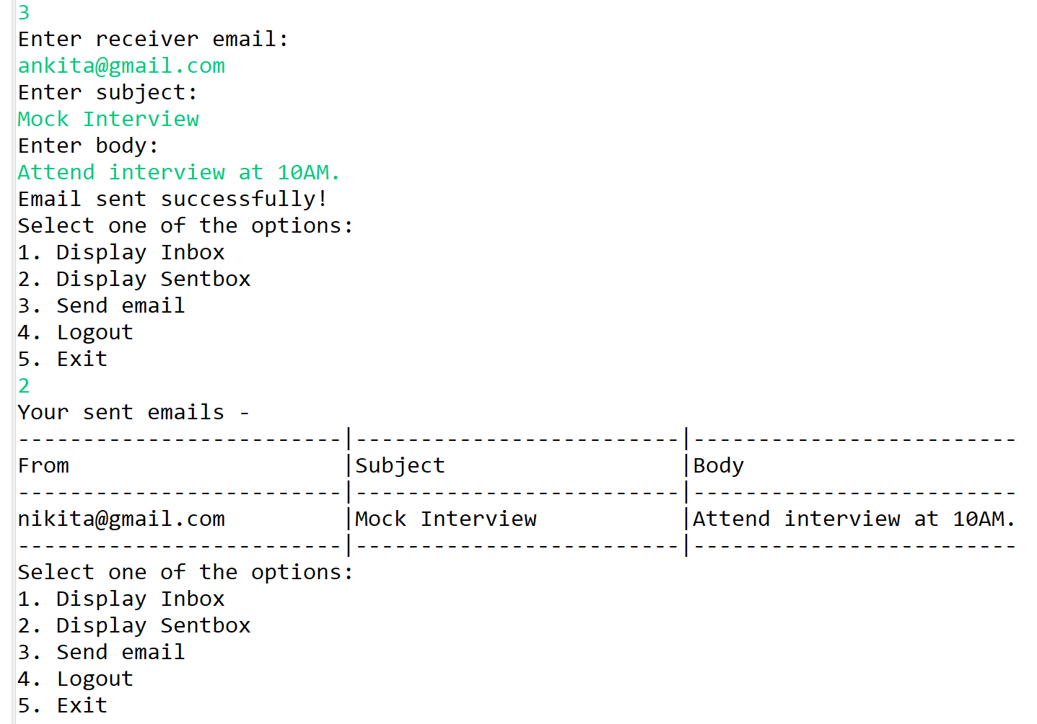
Scrshot 3 and 4: Some demo emails are created to view the received emails using for loop and sent an email to view the sent emails. After completion of this process user can either logout or exit the application.

Slide 9
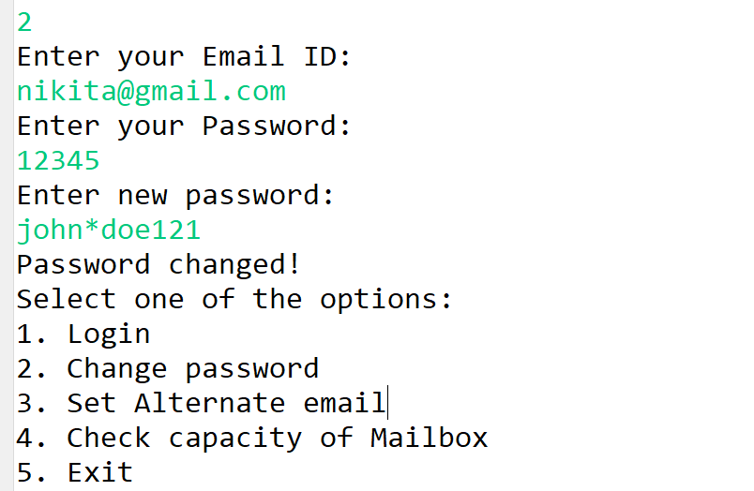
2. Change Password
eat
Scrshot 5: A method change password created using simple if-else statement

Slide 10
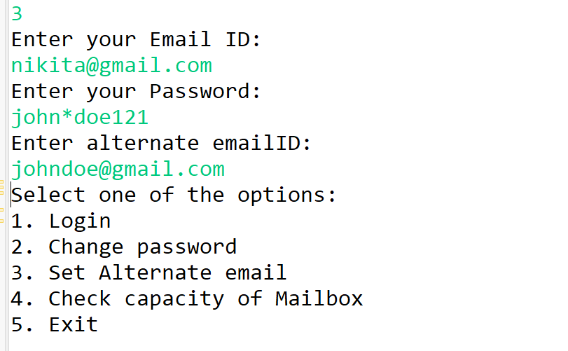
3. Set an alternate email
Scrshot 6: Method alter_email used via if-else conditional statement to set another email on temporary basis

Slide 11
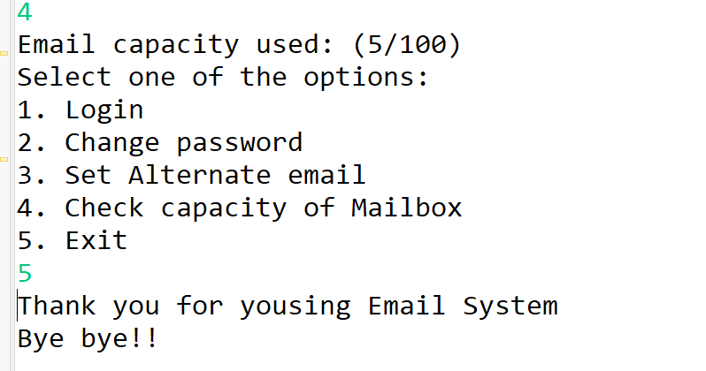
4. Mailbox Capacity
Scrshot7: System can contains only 100 emails only.

Slide 12
ADVANTAGES
E-mails turn to be cheaper alternative to telephone conversation.
Eliminates time spent in establishing telephone calls.
Email saves environment as it is a paperless communication.
Emails are more convenient than any other mode of communication.

Slide 13
DISADVANTAGES
This system has limited number of emails
There is a chance of leakage of information through email if a mail server hacked
An Email may carry the virus to you, so all time you should care about it.

Slide 14
THANK YOU!

